Slide 1
Teaching the answer model to read our passages
SPEAKER NOTES
This deck covers the generator half of RAG finetuning: what we train, on what data, the Mac attempt and the Colab A100 run, what improved on an unseen document, and the answer to whether it is overfit.
GEHA DENTAL RAG · GENERATOR FINETUNING
LoRA instruction finetuning of Qwen2.5‑1.5B‑Instruct on direct and chain‑of‑thought examples
October 2026 · experiment log · results from the Colab A100 run, 21 Oct
Notes:
This deck covers the generator half of RAG finetuning: what we train, on what data, the Mac attempt and the Colab A100 run, what improved on an unseen document, and the answer to whether it is overfit.

Slide 2
Two places to finetune a RAG system
SPEAKER NOTES
The retriever work changed which chunks reach the model. This work changes the model that writes the answer. The two are independent: the retriever result came from an earlier experiment in the finetuning folder; the generator number is the Colab A100 run, scored on the same held-out plan brochure.
RETRIEVER · DONE EARLIER
GENERATOR · THIS DECK
Which chunks the LLM sees
How the LLM answers from them
bge‑base‑en‑v1.5 embedding model, contrastive loss on question → chunk pairs.
Qwen2.5‑1.5B‑Instruct chat model, LoRA instruction finetuning on passage + question → answer.
Recall@5: 64.6% → 68.7% on the held‑out brochure
Answer F1: 0.51 → 0.57 on the held‑out brochure
The slide that started this: instruction finetuning with direct and chain‑of‑thought data (FLAN, arXiv 2210.11416)
Notes:
The retriever work changed which chunks reach the model. This work changes the model that writes the answer. The two are independent: the retriever result came from an earlier experiment in the finetuning folder; the generator number is the Colab A100 run, scored on the same held-out plan brochure.

Slide 3

The pipeline, end to end
SPEAKER NOTES
Four steps, each a script in finetuning_LLM_LORA. The base and tuned models are evaluated in the same process with the adapter switched off and on, so prompts and decoding are identical.
01
02
03
04
QA pairs
SFT builder
LoRA training
Held‑out eval
Synthetic RAGAS questions + reference answers from the GEHA dental PDFs
Gold passage + 2 distractors, shuffled. One direct and one chain‑of‑thought target each
Loss on answer tokens only. Keep the adapter with the lowest validation loss
Unseen plan brochure. Base vs tuned, same prompts; only the adapter differs
Why distractors: retrieval is never perfect, so the model must learn to ignore irrelevant chunks (the RAFT recipe).
Why two formats: mixing direct and chain‑of‑thought targets in one run is the FLAN multi‑task recipe.
prepare_sft.py → train_lora.py → plot_loss.py → eval_generator.py
Notes:
Four steps, each a script in finetuning_LLM_LORA. The base and tuned models are evaluated in the same process with the adapter switched off and on, so prompts and decoding are identical.

Slide 4
One question becomes two training examples
SPEAKER NOTES
Each of the 78 training questions produces a direct example and a chain-of-thought example: 156 in total. The rationale is extractive, not written by a model, which is cheaper but imperfect: in this very example the extracted evidence lines miss the line with the phone number, because that line shares few words with the answer. Worth improving with an LLM-written rationale later.
PROMPT · masked, not trained on
DIRECT TARGET · trained on
[1] guide p.6 · Plan features (distractor)
[2] guide p.2 · Contact us (gold)
[3] guide p.4 · Both plans include (distractor)
You can reach a FedViser … by calling 1‑855‑572‑1636 Monday through Friday from 8 a.m. to 8 p.m. Eastern time.
Question: What is the phone number to contact a FedViser for GEHA dental benefits?
CHAIN‑OF‑THOUGHT TARGET · trained on
Evidence:
- [2] “Reach a FedViser Monday‑Friday from 8 a.m.‑8 p.m.”
Answer: You can reach a FedViser … 1‑855‑572‑1636 …
Real example ragas‑0002 (abridged). Evidence is extractive: the gold sentences that overlap the reference answer most.
Notes:
Each of the 78 training questions produces a direct example and a chain-of-thought example: 156 in total. The rationale is extractive, not written by a model, which is cheaper but imperfect: in this very example the extracted evidence lines miss the line with the phone number, because that line shares few words with the answer. Worth improving with an LLM-written rationale later.

Slide 5

Data splits: the test set is a different document
SPEAKER NOTES
Train and validation come from the same guide but different sections, so validation loss tells us about unseen text in a familiar document. The test set is the plan brochure, a document the model never trains on, so it measures transfer. split_stats.py fails the run if any of the five checks fails.
 | train | validation | test
Document | guide | guide | brochure
Sections | 22 | 6 | 72
QA pairs | 78 | 24 | 41
SFT examples | 156 | 48 | 82
Distractor pool | 34 | 8 | 167
Prompt tokens, mean | 990 | 702 | 1,251
Answer tokens, mean | 135 | 120 | 199
Leakage checks: 5 of 5 pass
No shared chunk IDs
Train/val sections disjoint
Test document unseen
No repeated questions
Sources inside own split
Guide = 2026 GEHA dental benefits guide · Brochure = 2026 plan brochure · Report: results/data_splits.md
Notes:
Train and validation come from the same guide but different sections, so validation loss tells us about unseen text in a familiar document. The test set is the plan brochure, a document the model never trains on, so it measures transfer. split_stats.py fails the run if any of the five checks fails.

Slide 6
The model: a frozen 1.5B base with a small adapter
SPEAKER NOTES
LoRA freezes the base model and learns low-rank updates on every attention and MLP projection. Only 18.5 million weights train, which is why the saved adapter is 74 MB. With only 156 examples, an epoch is just 20 optimizer steps, which matters for the question of how many epochs to run.
1.5B
18.5M
20
74 MB
frozen weights in Qwen2.5‑1.5B‑Instruct
trainable LoRA weights, about 1.2% of the model
optimizer steps per epoch (156 examples ÷ batch 8)
adapter file on disk, vs about 3 GB for the base
LoRA | Targets | Optimizer | Selection
rank 16, alpha 32, dropout 0.05 | q, k, v, o, gate, up, down | AdamW 2e‑4, warmup + cosine | lowest validation loss
Adapter size measured from adapter_model.safetensors (fp32); base size is the bf16 checkpoint
Notes:
LoRA freezes the base model and learns low-rank updates on every attention and MLP projection. Only 18.5 million weights train, which is why the saved adapter is 74 MB. With only 156 examples, an epoch is just 20 optimizer steps, which matters for the question of how many epochs to run.

Slide 7



On the Mac: 4 h 41 min, one finished epoch
SPEAKER NOTES
Epoch 1 took 56 minutes, about 21 seconds per training example. Epoch 2 ran for three and a half hours without finishing because of battery throttling, a 12-minute hibernation and heavy swapping. That is why the full run moves to a Colab GPU.
02:53
03:57
06:39
07:34
Start on an M1 Pro, 32 GB, fp32 on the GPU (MPS)
Epoch 1 done in 56 min. Validation loss 0.626 → 0.517; adapter saved
Battery at 1%: the Mac hibernates for 12 min, epoch 2 still unfinished
Stopped. Full run moves to a Colab GPU
No bf16 on M1. fp32 doubles memory and compute compared with a bf16 GPU.
Ran on battery. macOS throttled the job, then hibernated it.
Memory pressure. 15.8 of 17 GB swap in use slowed every step.
Times are local (PDT), 21 Oct 2026, from the training log and macOS power log
Notes:
Epoch 1 took 56 minutes, about 21 seconds per training example. Epoch 2 ran for three and a half hours without finishing because of battery throttling, a 12-minute hibernation and heavy swapping. That is why the full run moves to a Colab GPU.

Slide 8
On a Colab A100: all 3 epochs in 3.5 minutes
SPEAKER NOTES
Same code, same data, same hyperparameters. The A100 trains in bf16 and has far more compute and memory bandwidth, so a full epoch took 71 seconds including validation, against 56 minutes on the Mac. The eval is now the slow part, because it generates 164 answers one token at a time with batch size 1.
56 min
71 s
≈47×
one epoch on the M1 Pro, fp32 on MPS
one epoch on an A100‑SXM4‑40GB, bf16, validation included
faster per epoch, same code and data
Colab stage | Time | Output
Training: 60 steps, 7 validation passes | 3.5 min | train_log.jsonl, best adapter
Eval: 82 examples × 2 models | ≈23 min | generator_comparison.json
Training time from train_log.jsonl (elapsed_s = 212); eval time from result file timestamps
Notes:
Same code, same data, same hyperparameters. The A100 trains in bf16 and has far more compute and memory bandwidth, so a full epoch took 71 seconds including validation, against 56 minutes on the Mac. The eval is now the slow part, because it generates 164 answers one token at a time with batch size 1.

Slide 9
Validation loss bottoms out after one epoch, then climbs
SPEAKER NOTES
Validation loss is checked every 10 steps. It falls for the first 20 steps, an epoch, and then rises for the remaining 40 while training loss keeps dropping. That is the textbook overfitting pattern. The trainer saves only the lowest-validation checkpoint, so the adapter that was evaluated is the epoch-1 one.
0.627
0.601
0.607
0.576
0.535
0.517
0.541
Best at epoch 1 (step 20): 0.517, down 17% from 0.627 before training.
Epochs 2–3: validation loss climbs back to 0.607 while train loss keeps falling to about 0.11.
Kept: only the epoch‑1 adapter, so the later epochs never reach the eval.
0
0.5
1
1.5
2
2.5
3
epoch
Validation = 24 questions × 2 formats from guide sections never trained on · Colab A100 run · bars start at zero
Notes:
Validation loss is checked every 10 steps. It falls for the first 20 steps, an epoch, and then rises for the remaining 40 while training loss keeps dropping. That is the textbook overfitting pattern. The trainer saves only the lowest-validation checkpoint, so the adapter that was evaluated is the epoch-1 one.

Slide 10
Is it overfit? Yes after epoch 1, and the kept adapter avoids it
SPEAKER NOTES
Yes, it overfits if you keep training: after epoch 1, validation loss rises every pass while training loss heads towards 0.1. But the run only keeps the lowest-validation adapter, so the model we use is the epoch-1 one, and on a document it never saw it still beats the base model. For the next run, train 1 epoch or turn on early stopping with patience 2 to save the wasted compute.
EPOCH 3
EPOCH 1 (KEPT)
UNSEEN DOCUMENT
train ≈0.11
val 0.607
val 0.517
On the brochure the kept adapter beats the base model: answer F1 +0.06, gold citations +0.12.
Lowest validation loss of the run. Best‑checkpoint selection saved this adapter, and it is the one evaluated.
The gap between validation and recent training loss grows from −0.07 to +0.48: the model memorizes the 78 training answers.
So it generalizes, but the margin is small and part of it is style.
Your 1–2 epoch instinct was right for this data: 20 optimizer steps were enough
Notes:
Yes, it overfits if you keep training: after epoch 1, validation loss rises every pass while training loss heads towards 0.1. But the run only keeps the lowest-validation adapter, so the model we use is the epoch-1 one, and on a document it never saw it still beats the base model. For the next run, train 1 epoch or turn on early stopping with patience 2 to save the wasted compute.

Slide 11
On the unseen brochure, the tuned model answers better
SPEAKER NOTES
Both models saw identical prompts: the gold passage plus two distractors. Answer F1 rose about 0.06 in both formats, and the tuned model was better on 27 of 41 direct questions and 29 of 41 chain-of-thought ones. Citation precision rose 0.12. Quote grounding did not change, and the base model already followed the evidence format. Two cautions: the confidence intervals nearly reach zero with 41 questions and one seed, and the tuned answers are 26 words longer, closer to the 107-word references, which by itself lifts token F1.
Metric (41 questions each) | Base | Tuned | Change | 95% CI | Better / worse
Answer F1, direct | 0.51 | 0.57 | +0.06 | +0.002 to +0.109 | 27 / 14
Answer F1, chain of thought | 0.49 | 0.54 | +0.06 | +0.000 to +0.108 | 29 / 11
Cites the gold passage | 0.72 | 0.84 | +0.12 | −0.008 to +0.240 | 15 / 4
Quotes found in passages | 0.87 | 0.87 | 0.00 | −0.104 to +0.097 | 7 / 7
CoT format followed | 1.00 | 1.00 | 0.00 | – | –
Answer length, words | 62 | 88 | +26 | reference: 107 | –
Real gain: better on about two‑thirds of questions, and cites the gold passage over a distractor more often.
Read with care: the intervals almost touch zero, and longer answers closer to the reference length also raise F1.
Epoch‑1 adapter vs base, same prompts, greedy decoding · paired bootstrap over questions, 5,000 resamples · one training seed
Notes:
Both models saw identical prompts: the gold passage plus two distractors. Answer F1 rose about 0.06 in both formats, and the tuned model was better on 27 of 41 direct questions and 29 of 41 chain-of-thought ones. Citation precision rose 0.12. Quote grounding did not change, and the base model already followed the evidence format. Two cautions: the confidence intervals nearly reach zero with 41 questions and one seed, and the tuned answers are 26 words longer, closer to the 107-word references, which by itself lifts token F1.

Slide 12
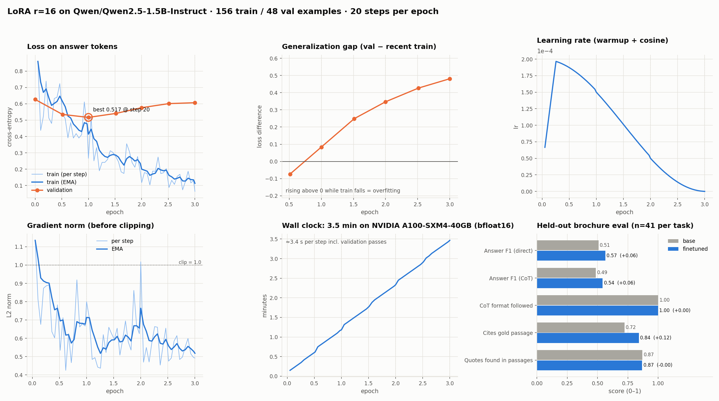
The whole run on one page
SPEAKER NOTES
Produced by plot_metrics.py from train_log.jsonl and generator_comparison.json. Top row: loss, the generalization gap, which crosses zero just before epoch 1 and keeps rising, and the learning-rate schedule. Bottom row: gradient norm staying under the clip, wall clock at about 3.4 seconds per step on the A100, and the base-versus-tuned eval.
Notes:
Produced by plot_metrics.py from train_log.jsonl and generator_comparison.json. Top row: loss, the generalization gap, which crosses zero just before epoch 1 and keeps rising, and the learning-rate schedule. Bottom row: gradient norm staying under the clip, wall clock at about 3.4 seconds per step on the A100, and the base-versus-tuned eval.

Slide 13
What we learned, and what to run next
SPEAKER NOTES
Four points. One epoch is the right length for this dataset; anything more memorizes. The improvement on an unseen document is genuine but small and comes from a single seed. Repeat the run over several seeds before relying on it. And grade answers for correctness, not just word overlap, since part of the F1 gain comes from longer answers.
One epoch is enough here
The gain is real but modest
With 156 examples, 20 steps reach the best validation loss. Next run: --epochs 1, or --patience 2.
+0.06 answer F1 and +0.12 gold citations on an unseen document, from one seed and 41 questions.
Repeat across seeds
Grade beyond token F1
Three to five seeds at about 30 minutes each on an A100 tell us whether +0.06 holds.
Add an LLM‑judge or human check for correctness, and LLM‑written rationales instead of extractive ones.
finetuning_LLM_LORA/ · results/ · PR dougc333/geha#101
Notes:
Four points. One epoch is the right length for this dataset; anything more memorizes. The improvement on an unseen document is genuine but small and comes from a single seed. Repeat the run over several seeds before relying on it. And grade answers for correctness, not just word overlap, since part of the F1 gain comes from longer answers.

